Slide 1
June 28, 2020
Are We There Yet?
Mark 13:14-23
The Authenticity, Affliction and Authority of Jesus Christ, the Son of God

Slide 2
Mark 13:14-19
14 But when you see the ABOMINATION OF DESOLATION standing where it should not be (let the reader understand), then those who are in Judea must flee to the mountains. 15 The one who is on the housetop must not go down, or go in to get anything out of his house; 16 and the one who is in the field must not turn back to get his coat. 17 But woe to those who are pregnant and to those who are nursing babies in those days! 18 But pray that it may not happen in the winter. 19 For those days will be a time of tribulation such as has not occurred since the beginning of the creation which God created until now, and never will.

Slide 3
Mark 13:20-23
20 Unless the Lord had shortened those days, no life would have been saved; but for the sake of the elect, whom He chose, He shortened the days. 21 And then if anyone says to you, 'Behold, here is the Christ'; or, 'Behold, He is there'; do not believe him; 22 for false Christs and false prophets will arise, and will show signs and wonders, in order to lead astray, if possible, the elect. 23 But take heed; behold, I have told you everything in advance.

Slide 4
Revelation 6:15-17
15 Then the kings of the earth and the great men and the commanders and the rich and the strong and every slave and free man hid themselves in the caves and among the rocks of the mountains; 16 and they said to the mountains and to the rocks, "Fall on us and hide us from the presence of Him who sits on the throne, and from the wrath of the Lamb; 17 for the great day of their wrath has come, and who is able to stand?

Slide 5
The Purpose
Passages like Mark 13, Revelation 6-19 and others are a twofold alert:
To believers to be ready for the day of His return by living lives worthy of the gospel to which they have been called.
To unbelievers to repent of their sin and to trust in Jesus Christ as Lord and Savior lest they suffer, eternally suffer God’s judgment.

Slide 6
The Abomination of Desolation ^{(13:14-23)}
But when you see the ABOMINATION OF DESOLATION standing where it should not be (let the reader understand), then those who are in Judea must flee to the mountains.
20 But when you see Jerusalem surrounded by armies, then recognize that her desolation is near. 21 Then those who are in Judea must flee to the mountains, and those who are in the midst of the city must leave, and those who are in the country must not enter the city; 22 because these are days of vengeance, so that all things which are written will be fulfilled. 23 Woe to those who are pregnant and to those who are nursing babies in those days; for there will be great distress upon the land and wrath to this people; 24 and they will fall by the edge of the sword, and will be led captive into all the nations; and Jerusalem will be trampled under foot by the Gentiles until the times of the Gentiles are fulfilled. (Luke 21:20-24)

Slide 7
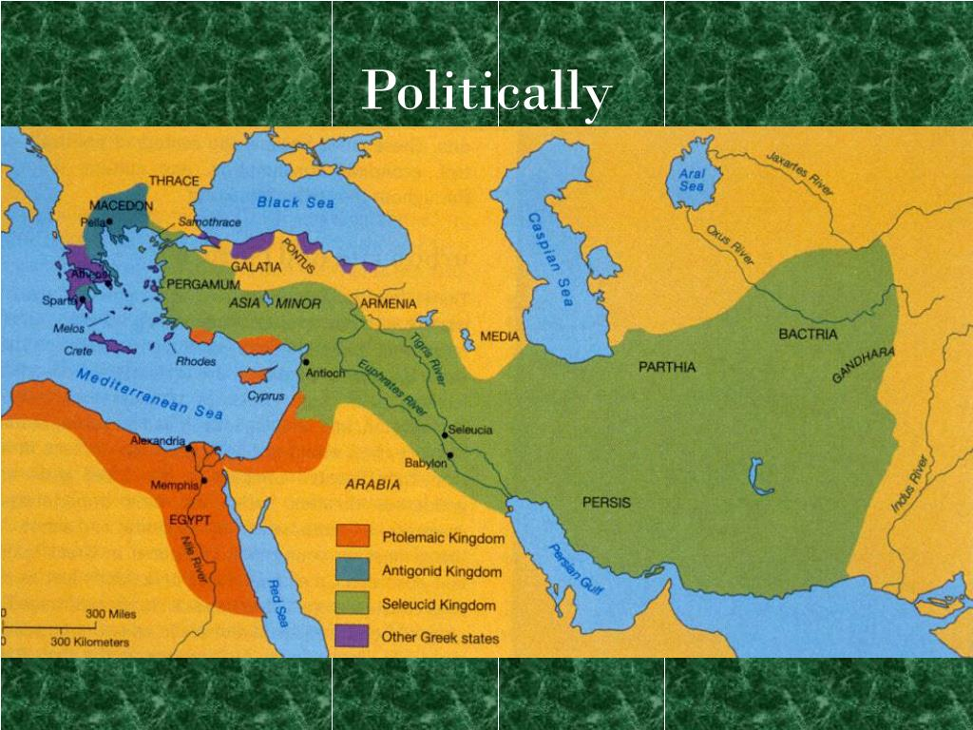
Revelation 6:15-17

Slide 8
Daniel 11:31
“Forces from him will arise, desecrate the sanctuary fortress, and do away with the regular sacrifice. And they will set up the abomination of desolation.”

Slide 9
Daniel 9:4-27
24 "Seventy weeks have been decreed for your people and your holy city, to finish the transgression, to make an end of sin, to make atonement for iniquity, to bring in everlasting righteousness, to seal up vision and prophecy and to anoint the most holy place. 25 So you are to know and discern that from the issuing of a decree to restore and rebuild Jerusalem until Messiah the Prince there will be seven weeks and sixty-two weeks; it will be built again, with plaza and moat, even in times of distress. 26 Then after the sixty-two weeks the Messiah will be cut off and have nothing, and the people of the prince who is to come will destroy the city and the sanctuary. And its end will come with a flood; even to the end there will be war; desolations are determined. 27 And he will make a firm covenant with the many for one week, but in the middle of the week he will put a stop to sacrifice and grain offering; and on the wing of abominations will come one who makes desolate, even until a complete destruction, one that is decreed, is poured out on the one who makes desolate.

Slide 10
Daniel’s Seventy weeks
Seventy “weeks” or units of sevens (contextually understood as seventy weeks of years) = 490 years
Sixty nine “weeks” = 483 years
Beginning with the decree to rebuild the walls of Jerusalem (King Artexeres in 444 BC)
Ends with Messiah being cut off (30 AD)
One final week (seven years) left of Israel’s history (Jacob’s Distress; Tribulation)

Slide 11
Daniel 11:36
“Then the king will do as he pleases, and he will exalt and magnify himself above every god and will speak monstrous things against the God of gods; and he will prosper until the indignation is finished, for that which is decreed will be done.”

Slide 12
Daniel 12:11
“From the time that the regular sacrifice is abolished and the abomination of desolation is set up, there will be 1,290 days.”

Slide 13
Mark 13:14-19
14 But when you see the ABOMINATION OF DESOLATION standing where it should not be (let the reader understand), then those who are in Judea must flee to the mountains. 15 The one who is on the housetop must not go down, or go in to get anything out of his house; 16 and the one who is in the field must not turn back to get his coat. 17 But woe to those who are pregnant and to those who are nursing babies in those days! 18 But pray that it may not happen in the winter. 19 For those days will be a time of tribulation such as has not occurred since the beginning of the creation which God created until now, and never will.

Slide 14
Luke 21:22-24
22 because these are days of vengeance, so that all things which are written will be fulfilled. 23 Woe to those who are pregnant and to those who are nursing babies in those days; for there will be great distress upon the land and wrath to this people; 24 and they will fall by the edge of the sword, and will be led captive into all the nations; and Jerusalem will be trampled under foot by the Gentiles until the times of the Gentiles are fulfilled.

Slide 15
Zechariah 13:8-9
8 “It will come about in all the land,” Declares the Lord, “That two parts in it will be cut off and perish; But the third will be left in it. 9 And I will bring the third part through the fire, Refine them as silver is refined, And test them as gold is tested. They will call on My name, And I will answer them; I will say, ‘They are My people,’ And they will say, ‘The Lord is my God.’”

Slide 16
Mark 13:20
“Unless the Lord had shortened those days, no life would have been saved; but for the sake of the elect, whom He chose, He shortened the days.”

Slide 17
Mark 13:21-22
21 "And then if anyone says to you, 'Behold, here is the Christ'; or, 'Behold, He is there'; do not believe him; 22 for false Christs and false prophets will arise, and will show signs and wonders, in order to lead astray, if possible, the elect.

Slide 18
2 Thessalonians 2:8-12
8 Then that lawless one will be revealed whom the Lord will slay with the breath of His mouth and bring to an end by the appearance of His coming; 9 that is, the one whose coming is in accord with the activity of Satan, with all power and signs and false wonders, 10 and with all the deception of wickedness for those who perish, because they did not receive the love of the truth so as to be saved. 11 For this reason God will send upon them a deluding influence so that they will believe what is false, 12 in order that they all may be judged who did not believe the truth, but took pleasure in wickedness.

Slide 19
Revelation 13:13-14
13 He performs great signs, so that he even makes fire come down out of heaven to the earth in the presence of men. 14 And he deceives those who dwell on the earth because of the signs which it was given him to perform in the presence of the beast, telling those who dwell on the earth to make an image to the beast who had the wound of the sword and has come to life.

Slide 20
Matthew 24:24-28
24 For false Christs and false prophets will arise and will show great signs and wonders, so as to mislead, if possible, even the elect. 25 Behold, I have told you in advance. 26 So if they say to you, 'Behold, He is in the wilderness,' do not go out, or, 'Behold, He is in the inner rooms,' do not believe them. 27 For just as the lightning comes from the east and flashes even to the west, so will the coming of the Son of Man be. 28 Wherever the corpse is, there the vultures will gather.

Slide 21
1 John 3:1-3
1 See how great a love the Father has bestowed on us, that we would be called children of God; and such we are. For this reason the world does not know us, because it did not know Him. 2 Beloved, now we are children of God, and it has not appeared as yet what we will be. We know that when He appears, we will be like Him, because we will see Him just as He is. 3 And everyone who has this hope fixed on Him purifies himself, just as He is pure.

Slide 22
June 28, 2020
Are We There Yet?
Mark 13:14-23
The Authenticity, Affliction and Authority of Jesus Christ, the Son of God

